Slide 1
Creating Markets While Creating Products Donna Novitsky CEO, Yiftee, Local gifts, on-the-go SCPD Entrepreneurship Educator, STVP Advisor October 2014

Slide 2

Product and market development are strategic and iterative processes that must be done simultaneously
…It takes two to tango

Slide 3

But Building a Market Is Hard!
No customers
No product
No budget
No pain
No one knows who you are

Slide 4
What You Do Have
A team of superstars
A game changing product coming to life
A compelling vision
Question…
What do customers care about?

Slide 5
Customers Care About Themselves!
As an entrepreneur you must demonstrate that you:
Comprehend
Their problem or opportunity
Competent
Have skills to solve or realize it
Care
Genuinely about their success

Slide 6
Leveraging What You Have (To Get What You Need: Customers)
Market the company, not only the product
Explore!
Market “the Player”
Lock in customers step-by-step with development
Bet wisely
Invest heavily in your bets

Slide 7
The Tango
Global rollout
A market is born!
Product goes live
References
Product Development Cycle
Production ready
product
Paying
customers!
Market Development Cycle
Debugging
and
beta
Product
feedback
& building
credibility
Whiteboard
to
alpha
Exploratory
meetings

Slide 8
Common Mistakes
Starting to sell too late
Over-emphasizing the product
Big company product testing process
And some others
The launch fizzle
Selling consulting projects
Ramping sales before product is ready
Ramping development before market is proven

Slide 9
Mistake 1. Starting to Sell Too Late
Where marketers and entrepreneurs go wrong:
What’s wrong with that?
What you must get right:
Building the vision
Build too much
Build the wrong stuff
Deliver too late
Identify minimum compelling feature set
Learn how to sell
Seek out early customer partners

Slide 10
The Tango
Global rollout
A market is born!
Product goes live
References
Product Development Cycle
Production ready
product
Paying
customers!
Market Development Cycle
Debugging
and
beta
Whiteboard
to
alpha

Slide 11
The Tango
Global rollout
A market is born!
Product goes live
References
Product Development Cycle
Production ready
product
Paying
customers!
Market Development Cycle
6-18 more months!
Debugging
and
beta
Product
feedback
& building
credibility
Whiteboard
to
alpha
Exploratory
meetings

Slide 12
Pinpoint Market Entry Point with Customers
Meet with 30 prospective customers in 3 months,
while engineering is developing the product
What are their priorities
Where is greatest pain
What do they do now to address it
What do competitors offer and promise
Listen Learn Refine
How are they organized
Who has the budget
Who makes decisions
How are you different

Slide 13
Mistake 2. Over-Emphasizing the Product
Where entrepreneurs go wrong:
What’s wrong with that?
What you must get right:
Product, not pain
Miss out on relationship
Delays in market development
Credibility before product
Demonstrate you can remove pain
Build a relationship

Slide 14
Selling Your Assets: “The Player”
Someone who can be “marketed” in lieu of established product
Characteristics of “The Player”
Builds rapport
Is a magnet for other Players
Knows the game inside out
Listens and communi-cates
Translates and prioritizes
Has respected experience/ knowledge
The Player’s expertise has more value to your first
customers, and less risk, than your product

Slide 15
Mistake 3. Big Company Customer Testing Process
Where entrepreneurs go wrong:
What’s wrong with that?
What you must get right:
Big company process
Insufficient strategic customer/market qualification up front
Not focused on referenceability
First customers in the right market
80% must buy

Slide 16
What Is the Early Product Testing Process?
Typically, very tactical
PM’s identify customers who will “test”
Customers identify feature, quality issues
PM’s evaluate customer input for current or future revisions
Engineering addresses
Company learns how to deliver, support product
Customers who test may or may not buy
Product is finalized
Product is launched

Slide 17
Why Is Early Product Testing Strategic?
The big company already has a market, a reputation and existing customer relationships
Startups do not!
The early product testing process is the first time your vision is being tested before the true judge: the customers
It must pass
It must lead to additional sales
It must lead to additional sales in the right markets
Or else you are back to ground zero in market development

Slide 18
The Tango
Global rollout
Market too small
Product goes live
References
Product Development Cycle
Production ready
product
Paying
customers!
Market Development Cycle
Debugging
and
beta
Product
feedback
& building
credibility
Whiteboard
to
alpha
Exploratory
meetings

Slide 19
Being Strategic Means Choosing the Right Customer Partners and Making them Referenceable
Q: What is a “wrong” customer?
Customer in wrong market
Not a large market with repeatable sales
Customer’s priorities are not mainstream
Unique development needed
Customer has no intention of buying when testing is complete
Opportunity cost
Lack of purchase is an implied bad reference
A: A customer who is not referenceable
Your early product testing process will establish your customer relationships, reputation and market
Whether you like it or not

Slide 20
Three Equally Important Goals of Early Product Testing in a Startup
The obvious: feedback to product development
The strategic: selecting the strategic customers
The tactical: establishing a base of die hard loyal customers

Slide 21
Key Takeaways Develop the Market as You Develop the Product
Don’t wait for product availability to learn about customers, sales processes, partnerships and competition
It’s about the customer – address his/her pain
The Player has more credibility than your product anyway!
Build credibility with potential customers and industry influencers so you can choose the right strategic market from the start
Identify minimum compelling features and get the product to market ASAP
Make SURE your initial customers are strong references and will help with launch
IT takes two to tango…

Slide 22
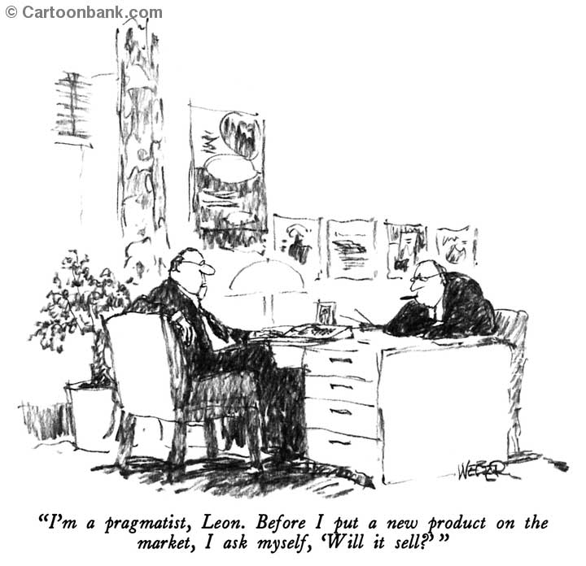
One Final Comment
“I’m a pragmatist, Leon. Before I put a new product on the market, I ask myself, ‘Will it sell?’”

Slide 23
b2C – GO TO MARKET
How do you get users?
Notes:
90% of traffic on mobile is app based

Slide 24

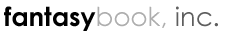


Hi, I’m Jon
SkiReport.com, Founder Acquired by Vail Resorts
FantasyBook, Founder Acquired by Citizen Sports
Citizen Sports, Lead Product Acquired by Yahoo!
InfoScout, Co-Founder/CTO … cranking away

Slide 25






The Cold Start Problem
Great idea at scale!... but how do you get there?
Success of your business largely dependent on your ability to get from 0 => 20 mph
Many plays are particular susceptible to the cold start…
Market Place Play
Social Play
UGC Play
Notes:
Biggest challenge will getting those first 5k users
Chicken and the egg
In these plays… key to provide value to your early users!!
Market Place: Often geo
Social Play: Small groups (twitter – company, facebook – harvard)
UGC: Can you seed the data?
Market Place: Ebay, Craigslist, etc.
Social: Facebook, Thumb
UGC: GasBuddy

Slide 26
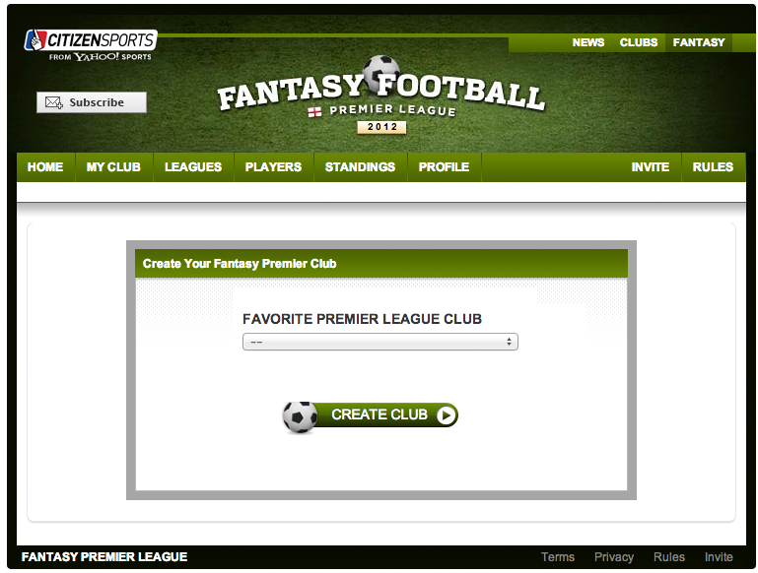
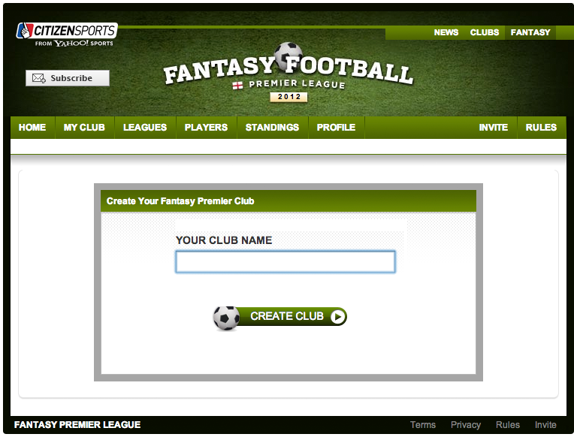
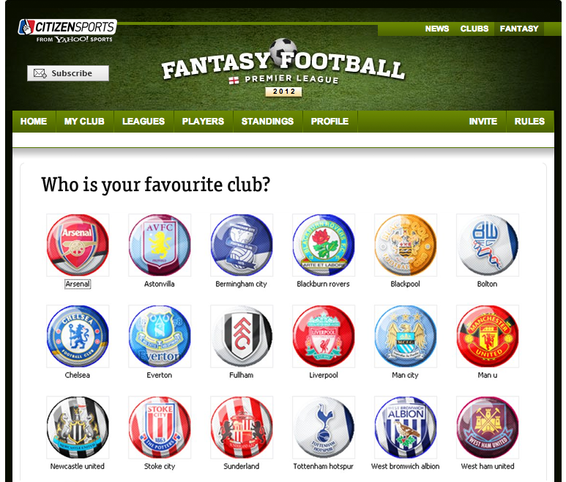
Optimize conversion funnel
Before diving in and dropping $, nail your message and optimize your conversion funnel on small number of users
Users more likely
to declare fanhood
Users like big logos
more than dropdown
65%
48%
77%
Notes:
Walk through example on in EPL how we went from a name => club => logos of a club
This is a iterative process!
Resources:
Google Website Optimizer
ABTests.com
You can spend 99% of the time on downstream experience… but doesn’t matter if users never get there

Slide 27
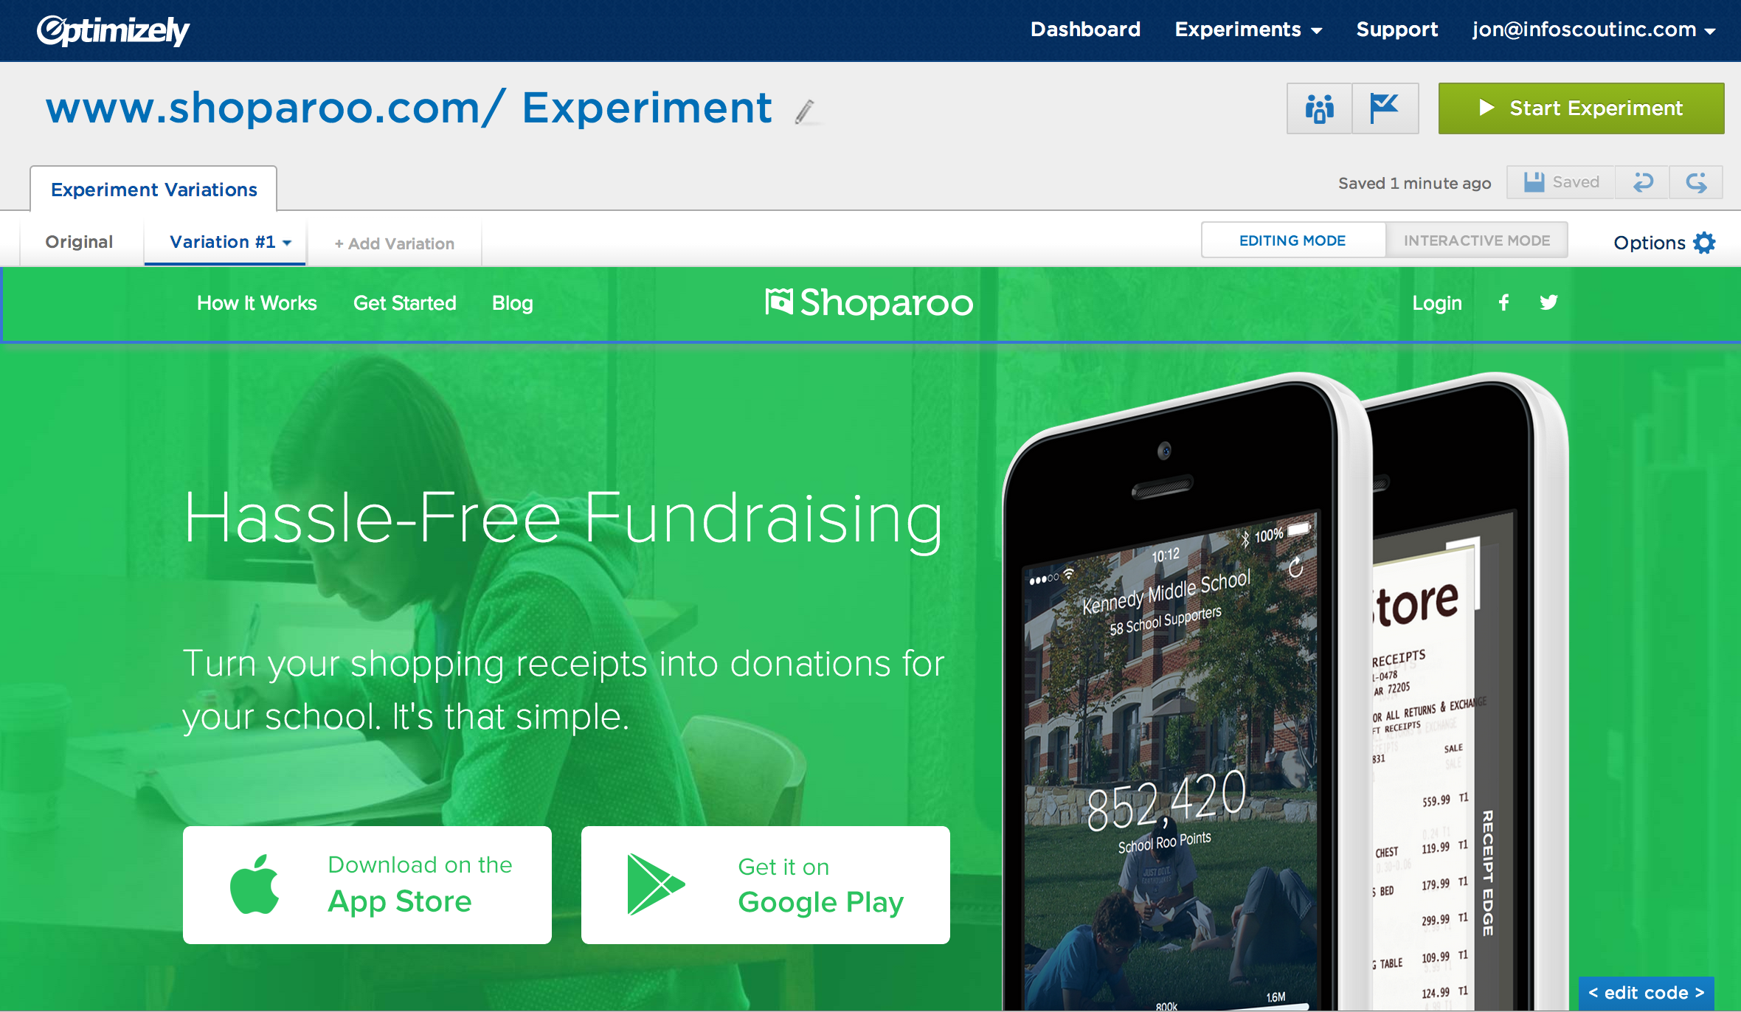
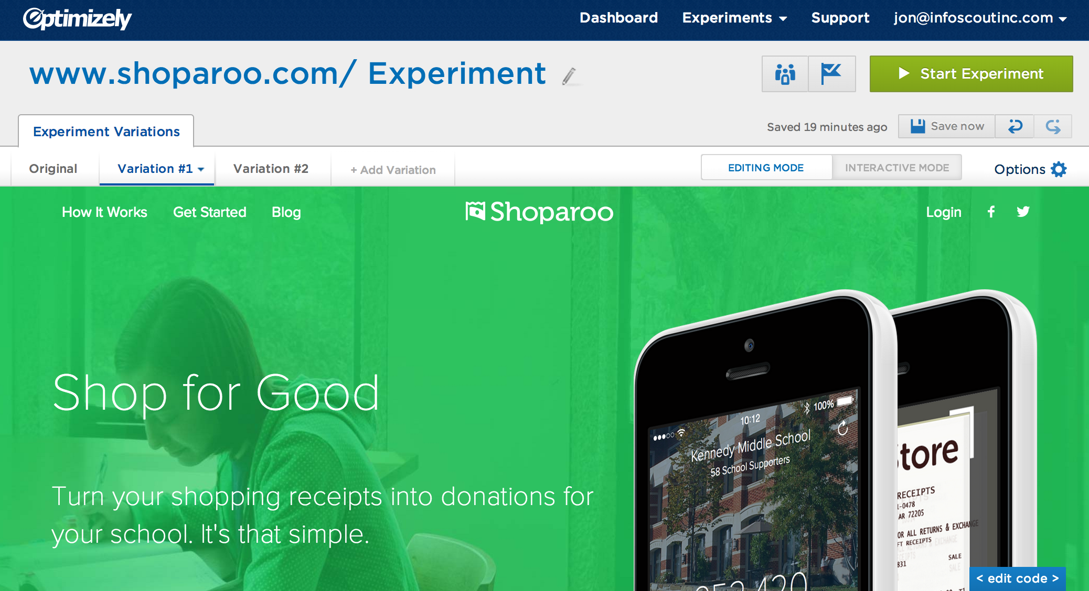
Optimizely
Incredibly easy tool to get started A/B testing

Slide 28
Measure, measure, measure
Tools to help:
Optimizely: A/B Testing
Google Analytics: Web/mobile analytics
KissMetrics: Event analytics, web & server-side
MixPanel: Mobile & funnel analytics
Unbounce: Landing page generator
DucksBoard: All analytics in one place
… many, many, more
Notes:
Ask audience if know any other tools they like??

Slide 29
Now you’re setup to measure
How do you find users??

Slide 30
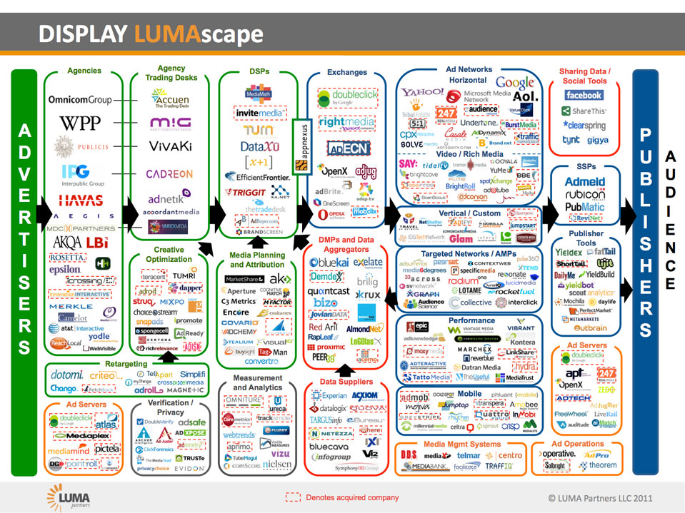
Notes:
It’s a complicated & vast space… will do my best to simplify it

Slide 31
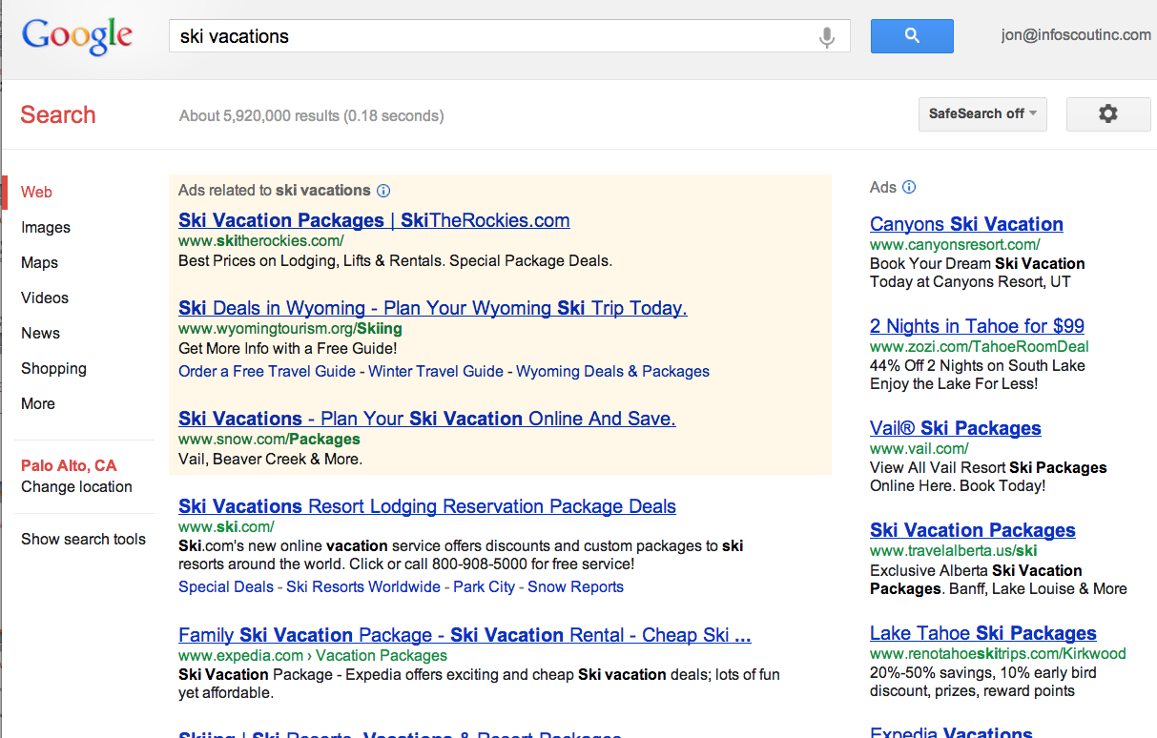
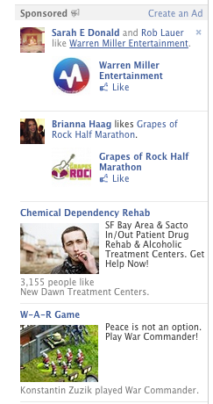
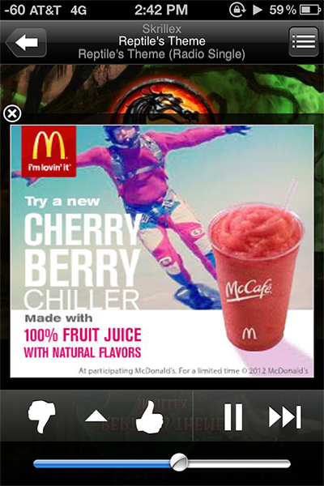
Paid Acquisition
Search (SEM), Facebook, Display Ads, Mobile Ad Networks
Lifetime Value of User (LTV)
Is your LTV > cost-per-user?
Which method to use?
Search
Display
Incentivized (i.e. CPI)
Retargeting
Many, many, more
Notes:
Get definition of LTV

Slide 32
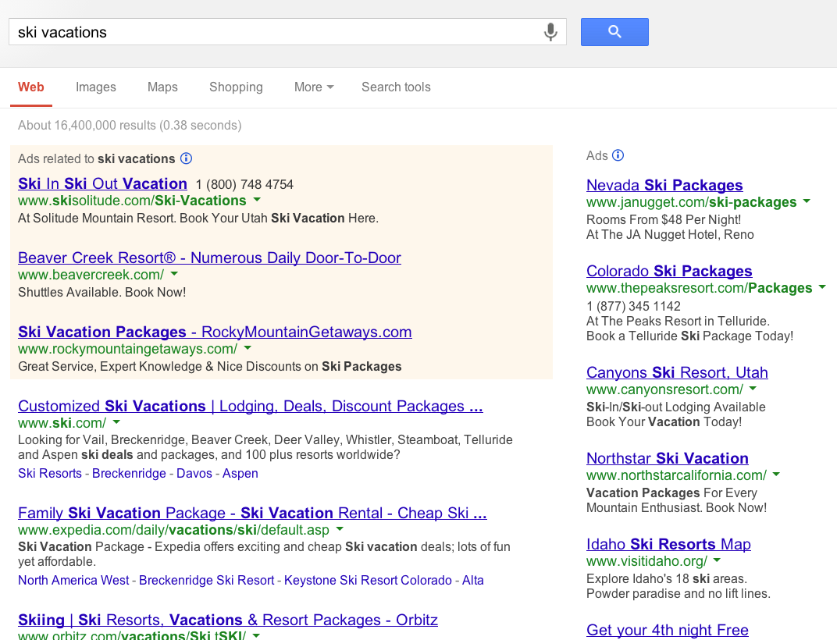
Paid Acquisition: Search
Head search phrases expensive, be creative with the tail
Relevance is key
i.e. AdWords Quality Score: ad content matching landing page
Careful with ‘broad match’
Maximize “Negative Keywords”
Use ‘Keyword Planner’ to gauge search volume
Major Players: Google, Bing, Yahoo
Notes:
Ask audience what percent of people in class click on search ads?
-- 6% of all search results are paid
… women (53%) click then men
Revenue per user/year (international)
-- Google: $10
-- Yahoo: $1.81
-- LinkedIn: $1.53
-- Facebook: $1.63
Revenue per user/year (US)
-- Google $29.95
-- LinkedIn: $8.79
-- Facebook: $6
Top categories:
Insurance ($54 max CPC),
Loans ($44),
Mortgage ($47.12)
Top keywords:
Insurance: $54
Loans: $44
Mortgage: $47
State Farm spent $43m last year, paying $43 for “self-employed health insurance”
Ask audience how much Google makes per user/year? (fun question)
Talk through platforms to help create ads:
AdWords, Efficient Frontier, Trada, etc.

Slide 33


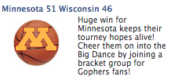
Paid Acquisition: Display
Deeply target creative to audience & landing page
Be creative: Leverage your data, current events, etc.
Avoid ad fatigue: Keep the ads dynamic
FB ad CTR declines by 50% on avg two days after released
CTR: 0.10%
CPC: $0.40
Create pool: 30%
Cost-per-pool: $1.20
CTR: 0.42%
CPC: $0.22
Create pool: 52%
Cost-per-pool: $0.42
CTR: 0.58%
CPC: $0.17
Create pool: 52%
Cost-per-pool: $0.33
Major Players: Facebook, Yahoo, Google, LinkedIn
Notes:
Facebook average CTR = 0.05% (1 in 2000)
Average cost is $0.25 / CPM
Facebook has served more impression on mobile than than desktop
FB #1 ($3.28b), Google #2 ($3b), Yahoo $1.2b

Slide 34
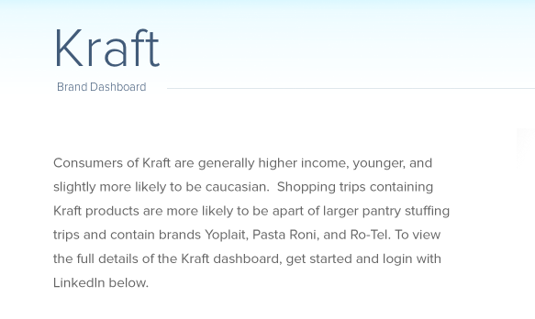
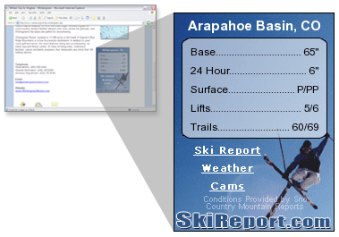
Organic: SEO
High quality inbound links and content is king
Difficult early on, attack the tail of search queries
Example: Custom high quality content
Example: Driving inbound links
Notes:
88 % of search result pages are organic
Talk high level of SEO (pagerank). Strategies that can work for your business (i.e. attacking the tail), doesn’t make sense for all businesses
Google panda update: attacked ‘thin’ sites. Content farms hurt (i.e. Panda)

Slide 35
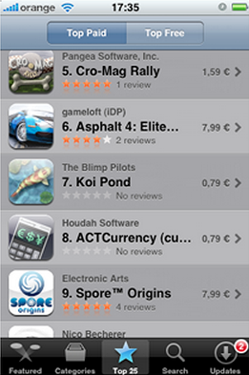
Organic: ASO (App Store Optimization)
Like SEO, find the right search queries to target
Rankings based on:
Title
Keywords
Recent Installs
Ratings
App-store rankings more critical for some categories than others
Games: rankings dynamic
Lifestyle/News: rankings static
Notes:
63% of apps found via app store search / browsing
http://techcrunch.com/2013/04/17/forrester-app-discovery-report/
Main Factors
Title
Tapjoy – Other paid networks
Appgratis – paid sure, get you to the top
Mobile App usage: 89% in Apps, 11% in Browser

Slide 36
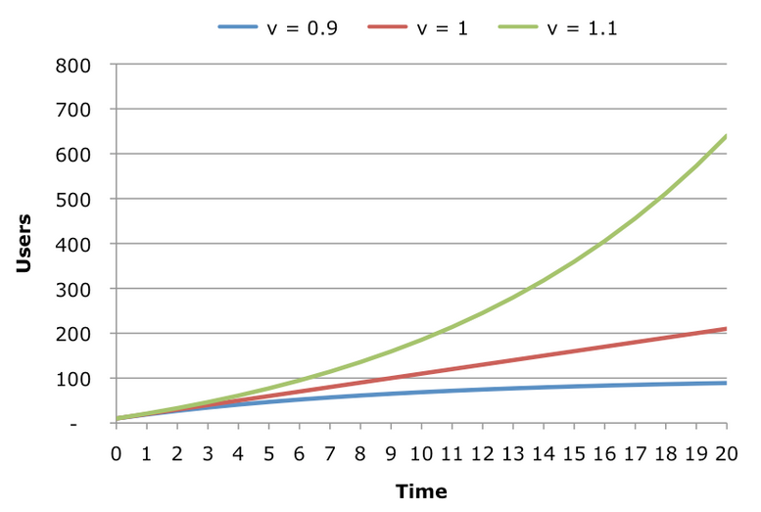
Organic: Virality
Many form of virality: inherit, incentivized, collaborative, etc
Virality Coefficient (k-factor)
Measures the invite and ‘word-of-mouth’ referral activity
Calculation (simplified): k = avg number of invites * conv rate
Notes:
It’s free and effective!! … but really hard
‘cycle time’ important!!

Slide 37
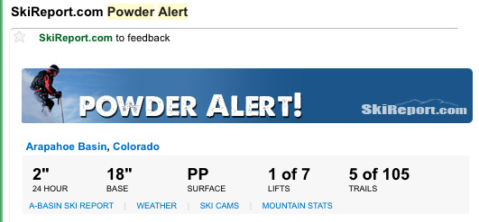
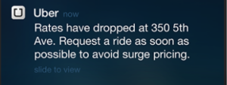
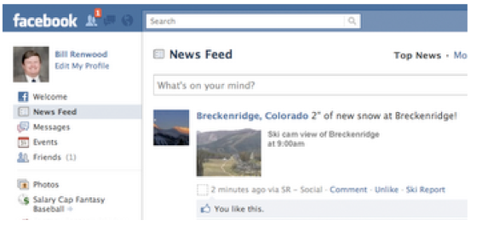
Retention
Push Notifications, Email, Social Media
Users forget about you!
Deliver the right message, at the right time, to the right medium
Resources: MailChimp, Urban Airship, Kahuana, Sendgrid, Hootsuite
Notes:
Go through good and bad examples of push

Slide 38
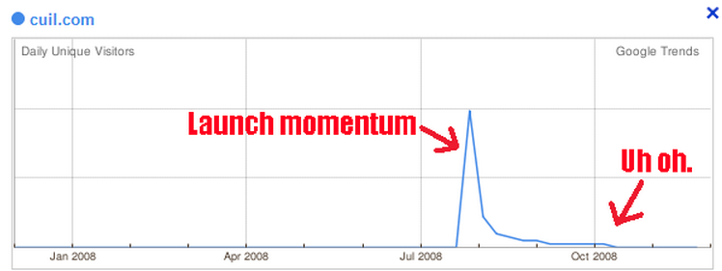
Press
Blog: use your data, create great stories!
Massive press launch?
Be careful, remember cuil.com?
Be prepared to capitalize on users/revenue
Notes:
Hire a PR agency? Go through the big launch and fail? Talk about pros/cons of press embargos, what press is looking for, etc.
Examples of good press, etc.

Slide 39
Move faster
The faster your iterate, the faster you grow…
Growth Hacker
Three roles in one: 1/3 Designer, 1/3 Hacker, 1/3 Product Mgr
Eliminates precious iteration time by using 1 person instead of 3
Increasing amount of acquisition & retention tools making this easier and easier
First mover advantage: Capitalize on new tech/platforms
Zynga: Capitalized on Facebook
Instagram: Capitalized on iOS
??: Capitalized on Google Glass
Notes:
Talk about the new role thrown around the valley ‘Growth Hacker’
Talk about how whoever moved the fastest on the Facebook platform won and all the cool examples there

Slide 40
B2B – GO TO MARKET
INBOUND MARKETING & LEAD GEN

Slide 41
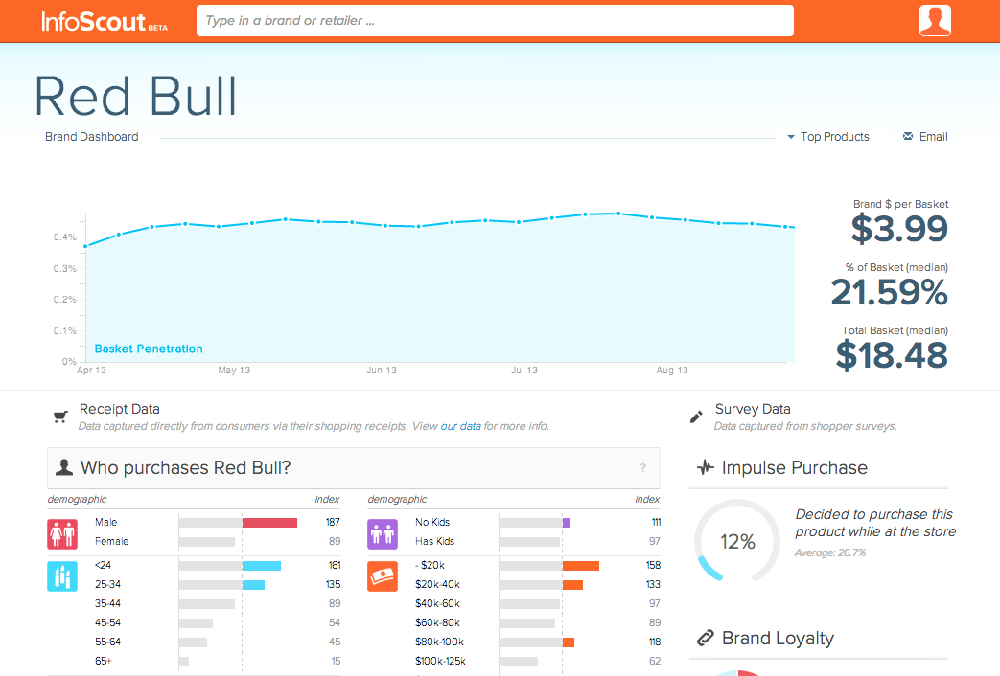
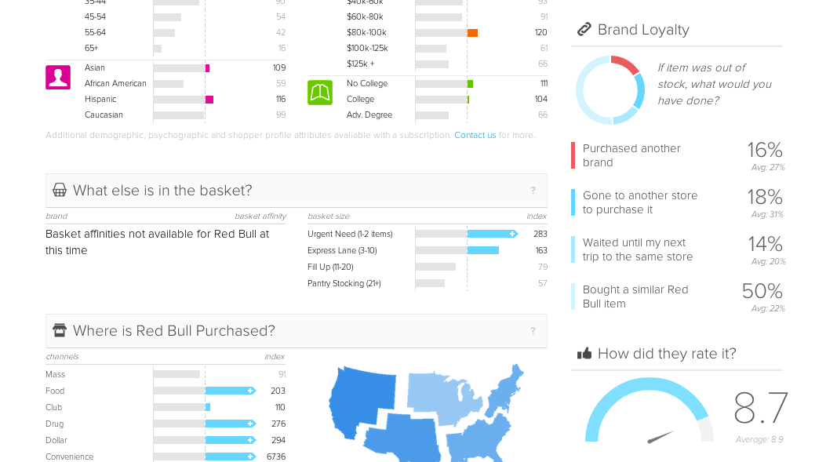
Inbound Marketing
Forms of inbound marketing
Newsletters
Blog posts
Videos
Podcasts
Quora posts
Leverage your content & data if you can!
HubSpot useful tool
InfoScout’s lead gen platform
Notes:
Ask class what other ones

Slide 42
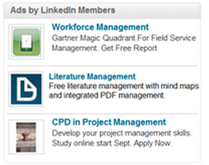
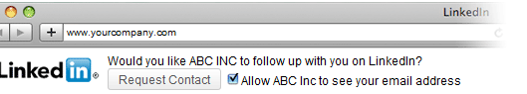
Digital Marketing
Paid search
Generally expensive for B2B, comes down to your LTV
Display ads
Effective when ability to deeply target
LinkedIn ad’s becoming popular
Targeting by position, company size, etc.

Slide 43
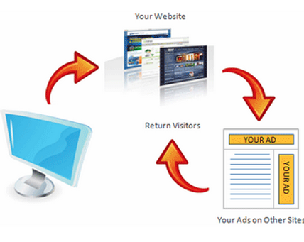
Remarketing
Stay in touch with your leads… after they leave your site!
Cost-efficient when your target audience is niche and hard to reach.
B2B marketing
Niche B2C plays
Advanced remarketing:
Based on products/pages viewed
Search remarketing
Major Players: Retargeter, Google, AdRoll
Notes:
Must for B2B

Slide 44
Thanks!
jon@infoscout.co

Slide 45
Resources
Reading Material
Andrew Chen Blog
Mary Meeker Internet Trends Report
SearchEngineLand
Matt Cutts Blog (SEO)
Seth Godin Blog
Research Tools
Quora
Quantcast (public web analytics)
AppAnnie (app store research)
AppData.com (fb/mobile analytics)
Tools
Optimizely
Google Analytics
Flurry
DucksBoard
MobileAppTracking
Unbounce
MailChimp
UrbanAirship
Notes:
Ask class what other ones

Slide 46

B2B Go-to-market considerations
Jack Fuchs

Slide 47
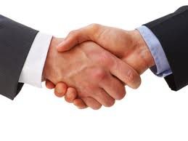
Partners
Enable focus
Reduce costs
Market access
Customer/supplier access
Innovation/differentiation
Expand sources of revenue

Slide 48
Partner Synergy
High
Opportunistic
Strategic
Early on, “Learning Partners” provide important bridges.
Value to Partner
Misfit
Orphan
Low
Low
Value to your Company
High

Slide 49
Core Partner Types
Supplier Partners
Manufacturing/
Distribution Partners
Influence Partners
Strategic Question:
Build or buy?
Role:
Enable faster time-to-market
Facilitate focus on core competencies
Reduce costs
Strategic Question:
Indirect or direct?
Role:
Extend sales reach
Accelerate sales
Reduce costs
Strategic Question:
Together or alone?
Role:
Provide brand leverage
Extend market reach
OTHERS?
Notes:
Battery vendors presently opportunistic as they are having a hard time to sell their existing capacity
Bauer also opportunistic, we get access to new shuttle bus markets where he knows a lot of the players
Detroit Chassis is a strategic partner, high value to both sides, have great relationships with suppliers like Ford

Slide 50
Technology Adoption Life Cycle
Crossing the Chasm
- Geoffrey Moore
Mainstream
Early Market
Late
Market
Chasm
Innovators
2%
Early Adopters
14%
Early Majority
34%
Late Majority
34%
Laggards
16%
Deal oriented
“Guess work”
Value-based
Goal=margin
Price inelastic
Cost-plus
Goal = market growth
Price often lower then entry price
Skim
Competition-based
Goal=market share
Price elastic
Penetration
Source: Adapted from Crossing the Chasm by Lynda Smith

Slide 51
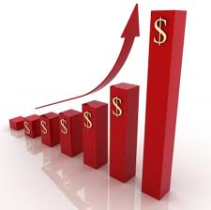
What is Sales?
Understanding a customer’s problem
Solving their problem
Earning customer’s trust
It is all about trust

Slide 52
Business Customers – Actors and Their Roles
Decision Maker
$$$$$
Economic Buyer
$$$
Recommenders
Influencers
Users

Slide 53
Difference - Sales & Marketing?
Sales listens
Marketing talks
Not everyone can make the transition

Slide 54
Building Sales Organization
Founders must be the first sales people
Do not hire too soon
Sales people hardest to hire
But easiest to fire

Slide 55
Types of Sales People
“Gladiators”
“Professional Sales” people

Slide 56
“Gladiators”
Solo hunters
They go away, don’t check-in frequently
Bring back customers having sold the product
They sell stuff you don’t quite have
They ask for forgiveness, not approval

Slide 57
“Professional Salesperson”
Usually trained at a big company
Require support staff to succeed
Good at taking orders and building relationships
Expensive

Slide 58
Timing
Need different people at different stages
Bootstrap seed series A series B series C exit

Slide 59
Sales Process
Tell prospects about the benefits of your product
Ask if any of these resonate with them
If not then ask what would
Then listen
They just told you how to sell to them

Slide 60
Takeaways
Create a process for repeatable sales
Don’t hire too soon – iterate & confirm the sales process first hand
Alliances & channel choice critical for startups

Slide 61
Gate I: Questions for CMO
What do you sell – be specific?
What is the burning need for your product/service? Who needs you most (describe your ideal customer)?
What is it about your product/service that uniquely satisfies that customer?
How does that offering differ from other offerings (current and future)?
What is the size of market – TAM and size of initial target segment (also describe the segment)?
How do you plan to attract customers (be as specific as you can)?

Slide 62
Market Sizing
Once you define WHO and WHAT, estimate target SIZE
TAM = Total Available Market
How big is the universe?
(top down ~industry,
bottom up ~ # users X price)
SAM = Market you “could” Serve
How many can I reach with my sales channel?
Base Camp(for a startup) =
Who will be the most likely buyers? What’s the basis for your revenue projections?
(Name market, quantify R$)
Total Available Market
Served Available Market
Base Camp

Slide 63
Gate I: Questions for CMO contd.
Have You Talked to Any Potential customers yet?
How much will customers be willing to pay for the product or service?
What is your GTM approach (draw scematic), and what part of your go-to-market approach do you plan to execute before the end of the quarter?
What novel approaches are you using as you take your product/service to market?
How do those novel approaches provide a sustainable advantage to your company?
What partnerships do you need in order to be successful in selling and marketing your product/service?

Slide 64
Additional Questions for CMO or CTO
What is the most compelling, novel aspect of your business?
What are the most important things that must be validated about your product and/or market to have the best chance of success?
What will you do over the next few weeks to validate those things?

Slide 65
Gate 1 Product Definition
Mike Lyons
Jack Fuchs

Slide 66
Gate I: Questions for CTO
What do you sell (define your product or service as explicitly as possible)?
Provide a schematic or diagram of your product
What unique technology are you applying to your product or service?
What is the current state of this technology?
What development has already taken place?
Who owns the rights to the technology?
Home Grown, Licensed (Provenance?)
Are technology partnerships required?

Slide 67
CTO Discussion, cont.
State of development by the end of the quarter? What technical developments achieved in the next 6 weeks?
Important milestones for the technology over the next 12 – 24 months?
Milestones, Timing, Some Idea of Resources
How does technology provide a sustainable advantage?
What is the most compelling differentiation of the technology?
How does your technology provide a sustainable advantage compared with other offerings?
How well do the capabilities of your technology match the needs of your target market?

Slide 68
Product Meets Market – Examples of Product Descriptions

Slide 69
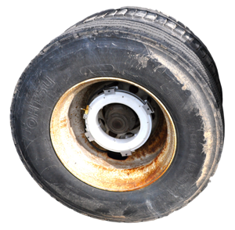
Introducing
The Halo Tire Inflator
A novel device, which utilizes a wheel’s rotational motion to automatically inflate its tires and maintain optimal tire pressure, increasing MPG, extending tire life, and eliminating blowouts.
Aperia Technologies, LLC 2011.

Slide 70
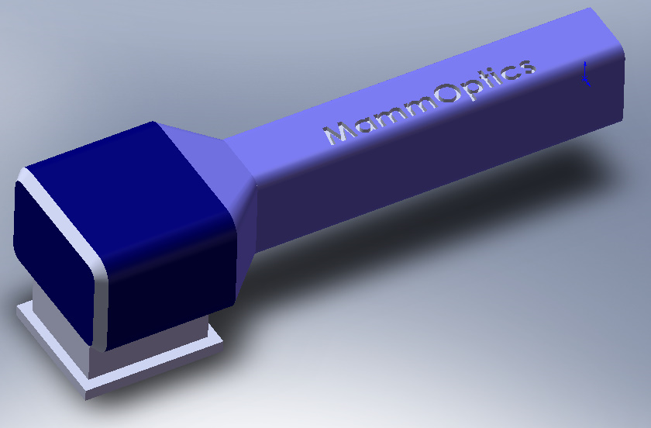

The MammOptics Technology
Hand-held, self contained breast cancer screening device
Digital Processing Unit
RF and Advanced
Integrated Circuit
Probe (Lasers
and Photo-detectors)
Disposable Skin Contact Head
9 Inches
~5 lbs

Slide 71
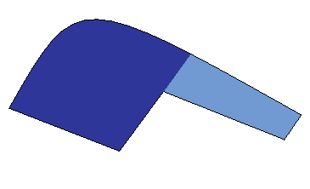

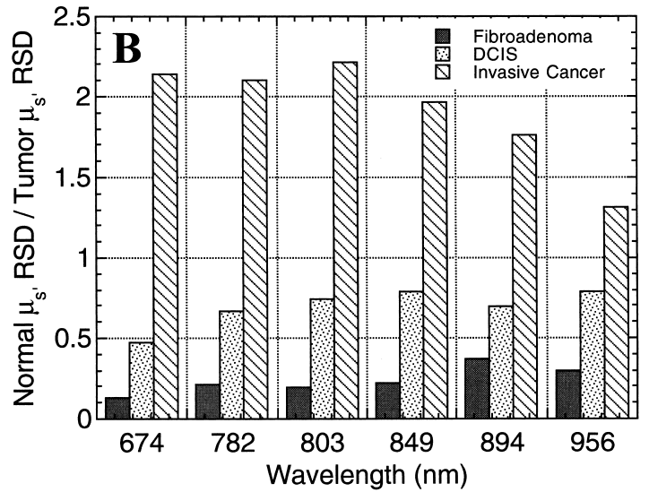
How it Works
Operates like a Radar system
Abnormality detected!
d = 1cm
d
Direction of probe
Different physiological content

Slide 72
Execution Beats Hypotheses
How will your team respond to those difficult questions…
Build your product or service and get reactions and statistics
Develop prototypes, screen-shots, demos, etc.
Measure, revise, measure, revise….

Slide 73
TA Announcements
Website fully functional and updated!!!
Thanks for submitting the assignments on time and correctly!
The TAs will be giving you feedback throughout the week
(Red Light, Yellow Light, Green Light)
Gate 1 this Saturday!
Thanks for signing up for spots

Slide 74
Gate 1
Prep
15 Min Presentation for CMO & CTO
50% presentation for CMO, 50% for CTO
Product / Market fit question types
15 min of Q&A from Panel
Prep
Look at Piazza announcement for guidelines
Feedback
We will give red/yellow/green feedback

Slide 75
Gate 1
Gate I Panelists
Mentors
David Bakker, Ofer Ronen, Mahesh Bhatia
Investors
Marcel Majon, xSeed
Founders
Matt Rabinowitz, CEO Natera
Vishal Parikh StartX, Motiv
Paul D’Antilio, CFO Start-up Weekend
Thomas Atchison, Mavericks Civilian Space Foundation
Pascal Levy-Garboua, SixDoors CEO

Slide 76
Announcements
Assignment 3 Due Monday 10/13 11:59PM
Financial Model Assumptions
Submit to msande273@gmail.com
Financial Modeling for Start-ups
Watch Peter Kent Video/PPT
Review financial model
Submit questions for Q&A by Monday 11:59pm
Upcoming classes
Speaker Prep: Mike Kourey, Khosla Ventures
Special Session: Financial modeling Deep Dive 10/16 5pm Nano 232

